Slide 1

ECE 419/619 Electric Machines and Drives
Inverters and Modulation

Slide 2
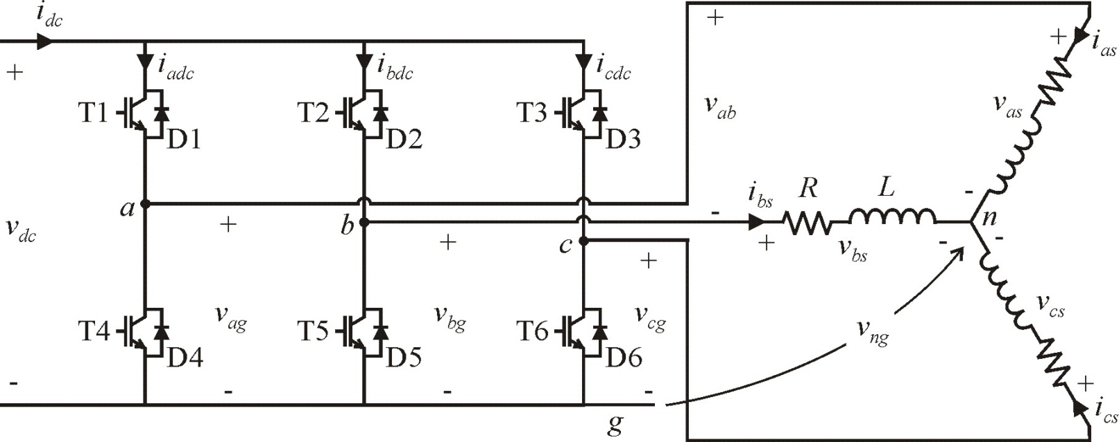
Inverters (Chapter 13)

Slide 3
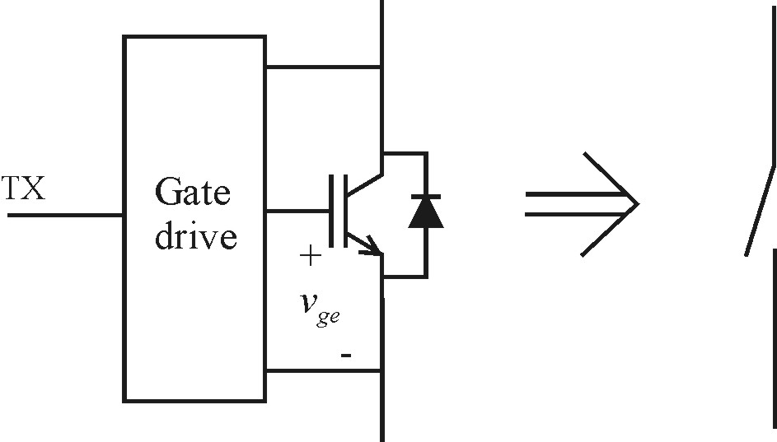
Model IGBTs as Ideal Switches
TX = control signal (from TTL or fiber optic)
v_{ge} = gate-to-emitter voltage
(usually 15V to gate on and -15V to gate off)

Slide 4
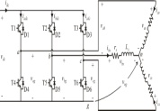
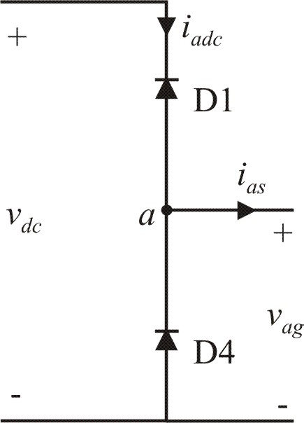
Switching State: T1=0, T4=0
D4 is on
D1 is on
output voltage depends on current direction
for our purposes, this state will not be used

Slide 5
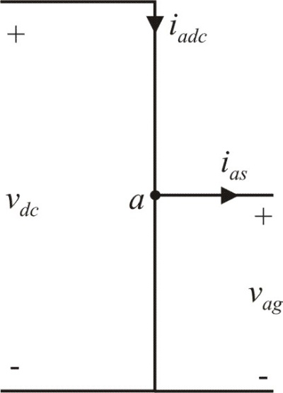
Switching State: T1=1, T4=1
current shoot-through
not a useful state

Slide 6
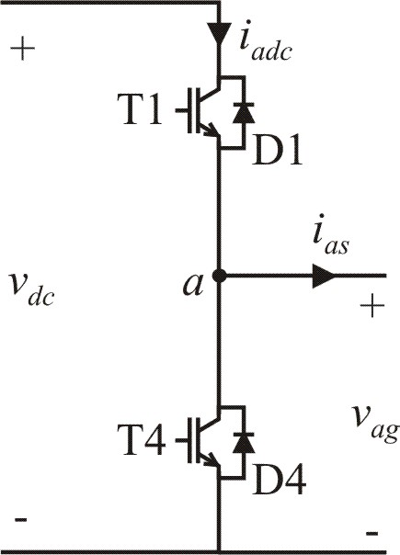
Useful States
T1 | T4 | v_{ag} | i_{adc}
0 | 1 | 0 | 0
1 | 0 | v_{dc} | i_{as}
Note:
total dc current

Slide 7
Inverter KVL Equations

Slide 8
Neutral-to-Ground Voltage
by KCL:
so
for an R-L load
← also true for PMSMs and IMs
then

Slide 9
Line-to-Neutral Voltage Equations
in matrix form

Slide 10
Line-to-Line Voltages
in matrix form

Slide 11
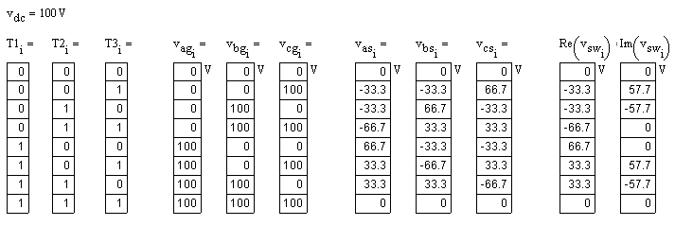
Inverter Voltage Vectors
define complex voltage vector
evaluate for all switching states

Slide 12
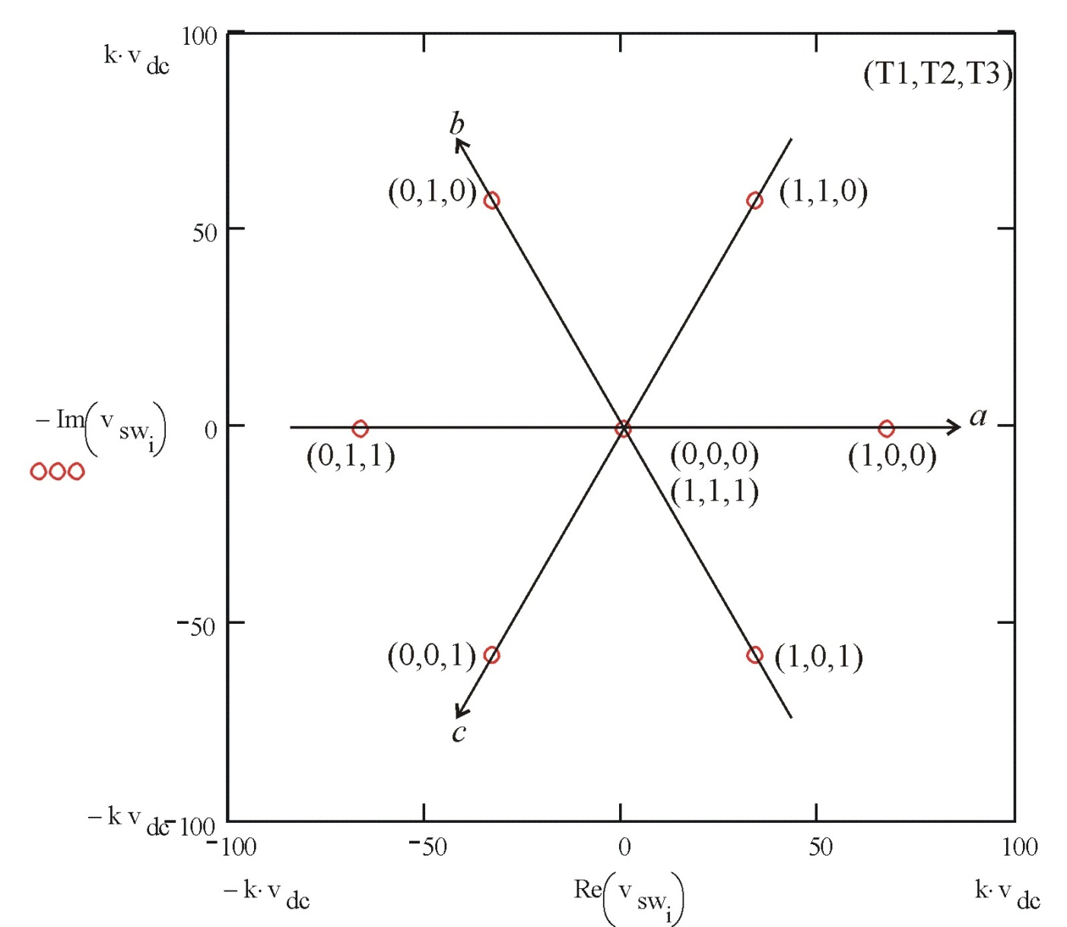
Voltage Vector Plot

Slide 13
Basic Inverter Concepts
Line-to-ground voltages are directly controlled by the inverter.
Load voltages (line-to-neutral in a wye-connected system) are directly related to the line-to-ground voltages.
Voltage vectors provide a method of inverter analysis and understanding based on the rotating voltage concept.

Slide 14
Inverter Switching with 180º VSI
According to voltage vector plot, step from one vector to the next
to produce an approximate rotating voltage vector in the sequence

Slide 15
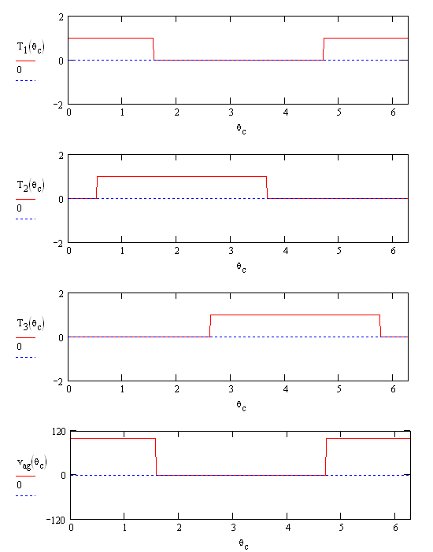
Inverter Example: 180º VSI
θ_{c} = 2πft
R = 2 Ω
L = 1 mH
f = 100 Hz
v_{dc} = 100 V
v_{as1} = 63.7 V

Slide 16
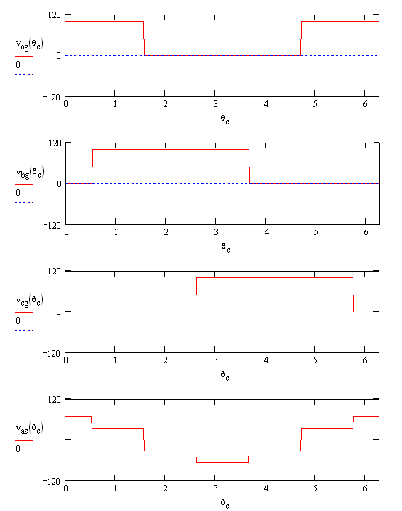
Inverter Example: 180º VSI
1 1 0 0 0 1 1
θ_{c} = 2πft
R = 2 Ω
L = 1 mH
f = 100 Hz
v_{dc} = 100 V
v_{as1} = 63.7 V
0 1 1 1 0 0 0
0 0 0 1 1 1 0

Slide 17
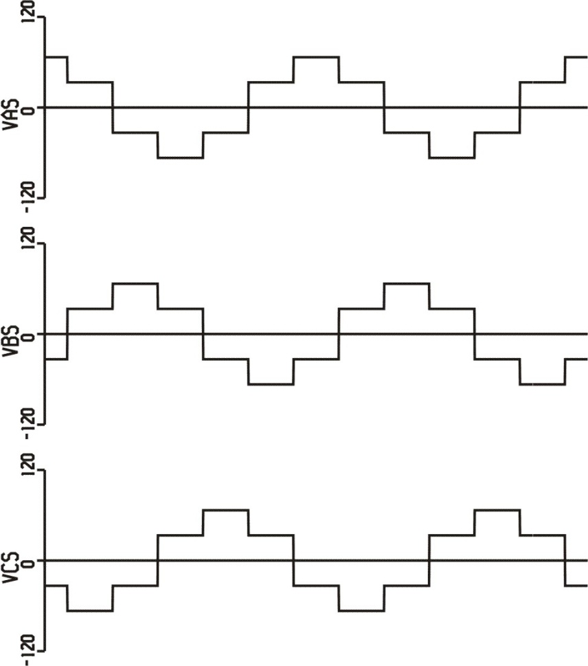
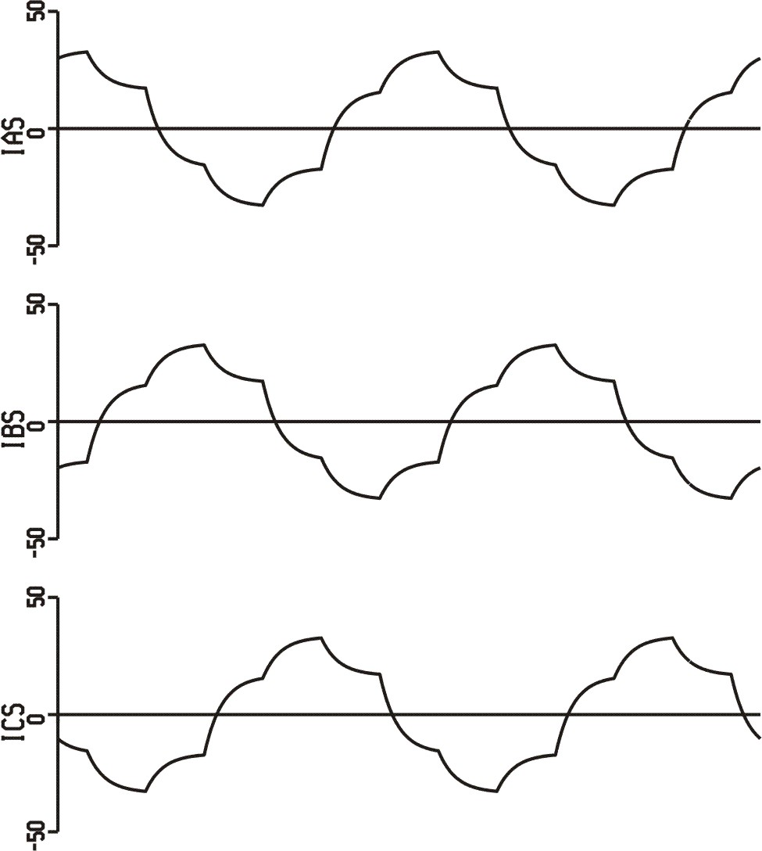
180º VSI Voltages and Currents
line-to-neutral voltages
load currents

Slide 18
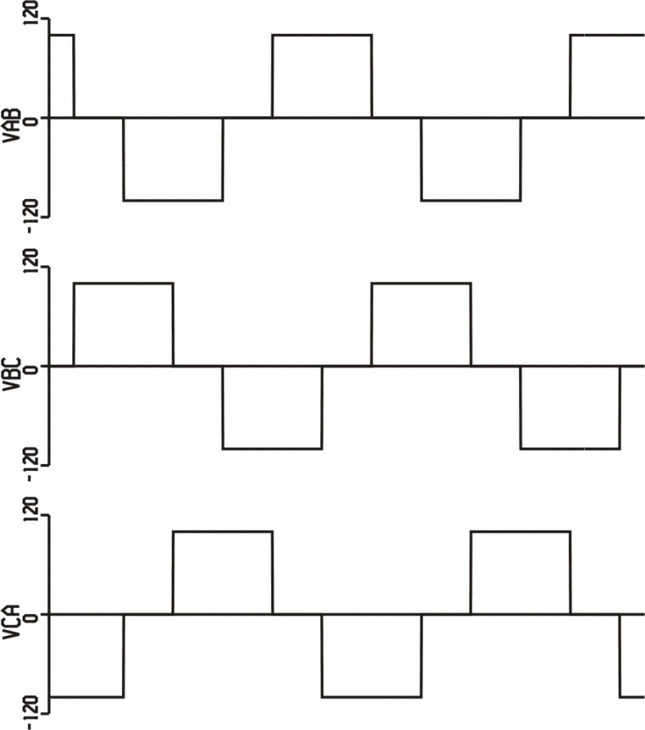
180º VSI Voltages
line-to-neutral voltages
line-to-line voltages

Slide 19
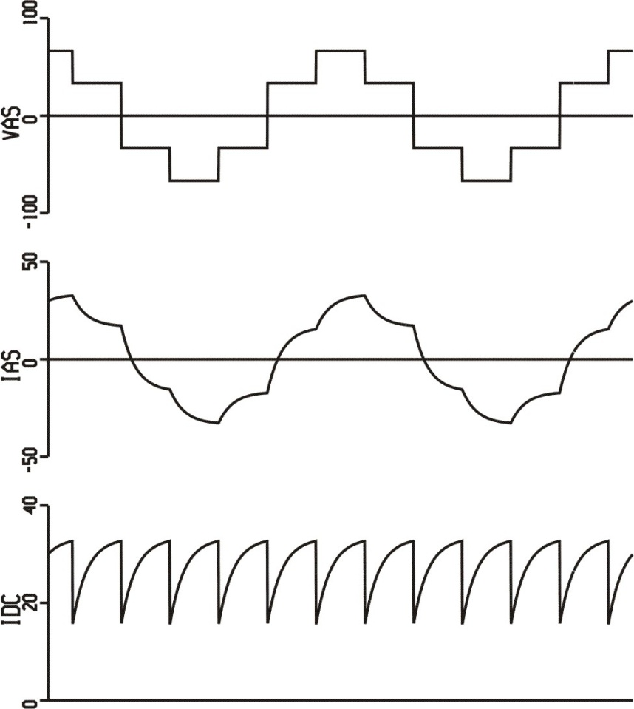
180º VSI Voltages and Currents

Slide 20
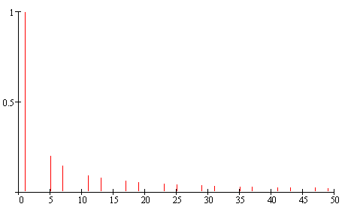
Line-to-Neutral Voltage Harmonics
fundamental component
harmonics 5, 7, 11, 13, 17, 19, …

Slide 21
Fundamental Calculations

Slide 22
U(0,1,0)
U(1,1,0)
Sector 2
Sector 3
Sector 1
U(0,1,1)
U(1,0,0)
0
Sector 4
Sector 6
Sector 5
U(0,0,1)
U(1,0,1)

Slide 23
Harmonic Calculations

Slide 24
180º VSI Simulink Example
Inverter_Bridge.mdl

Slide 25
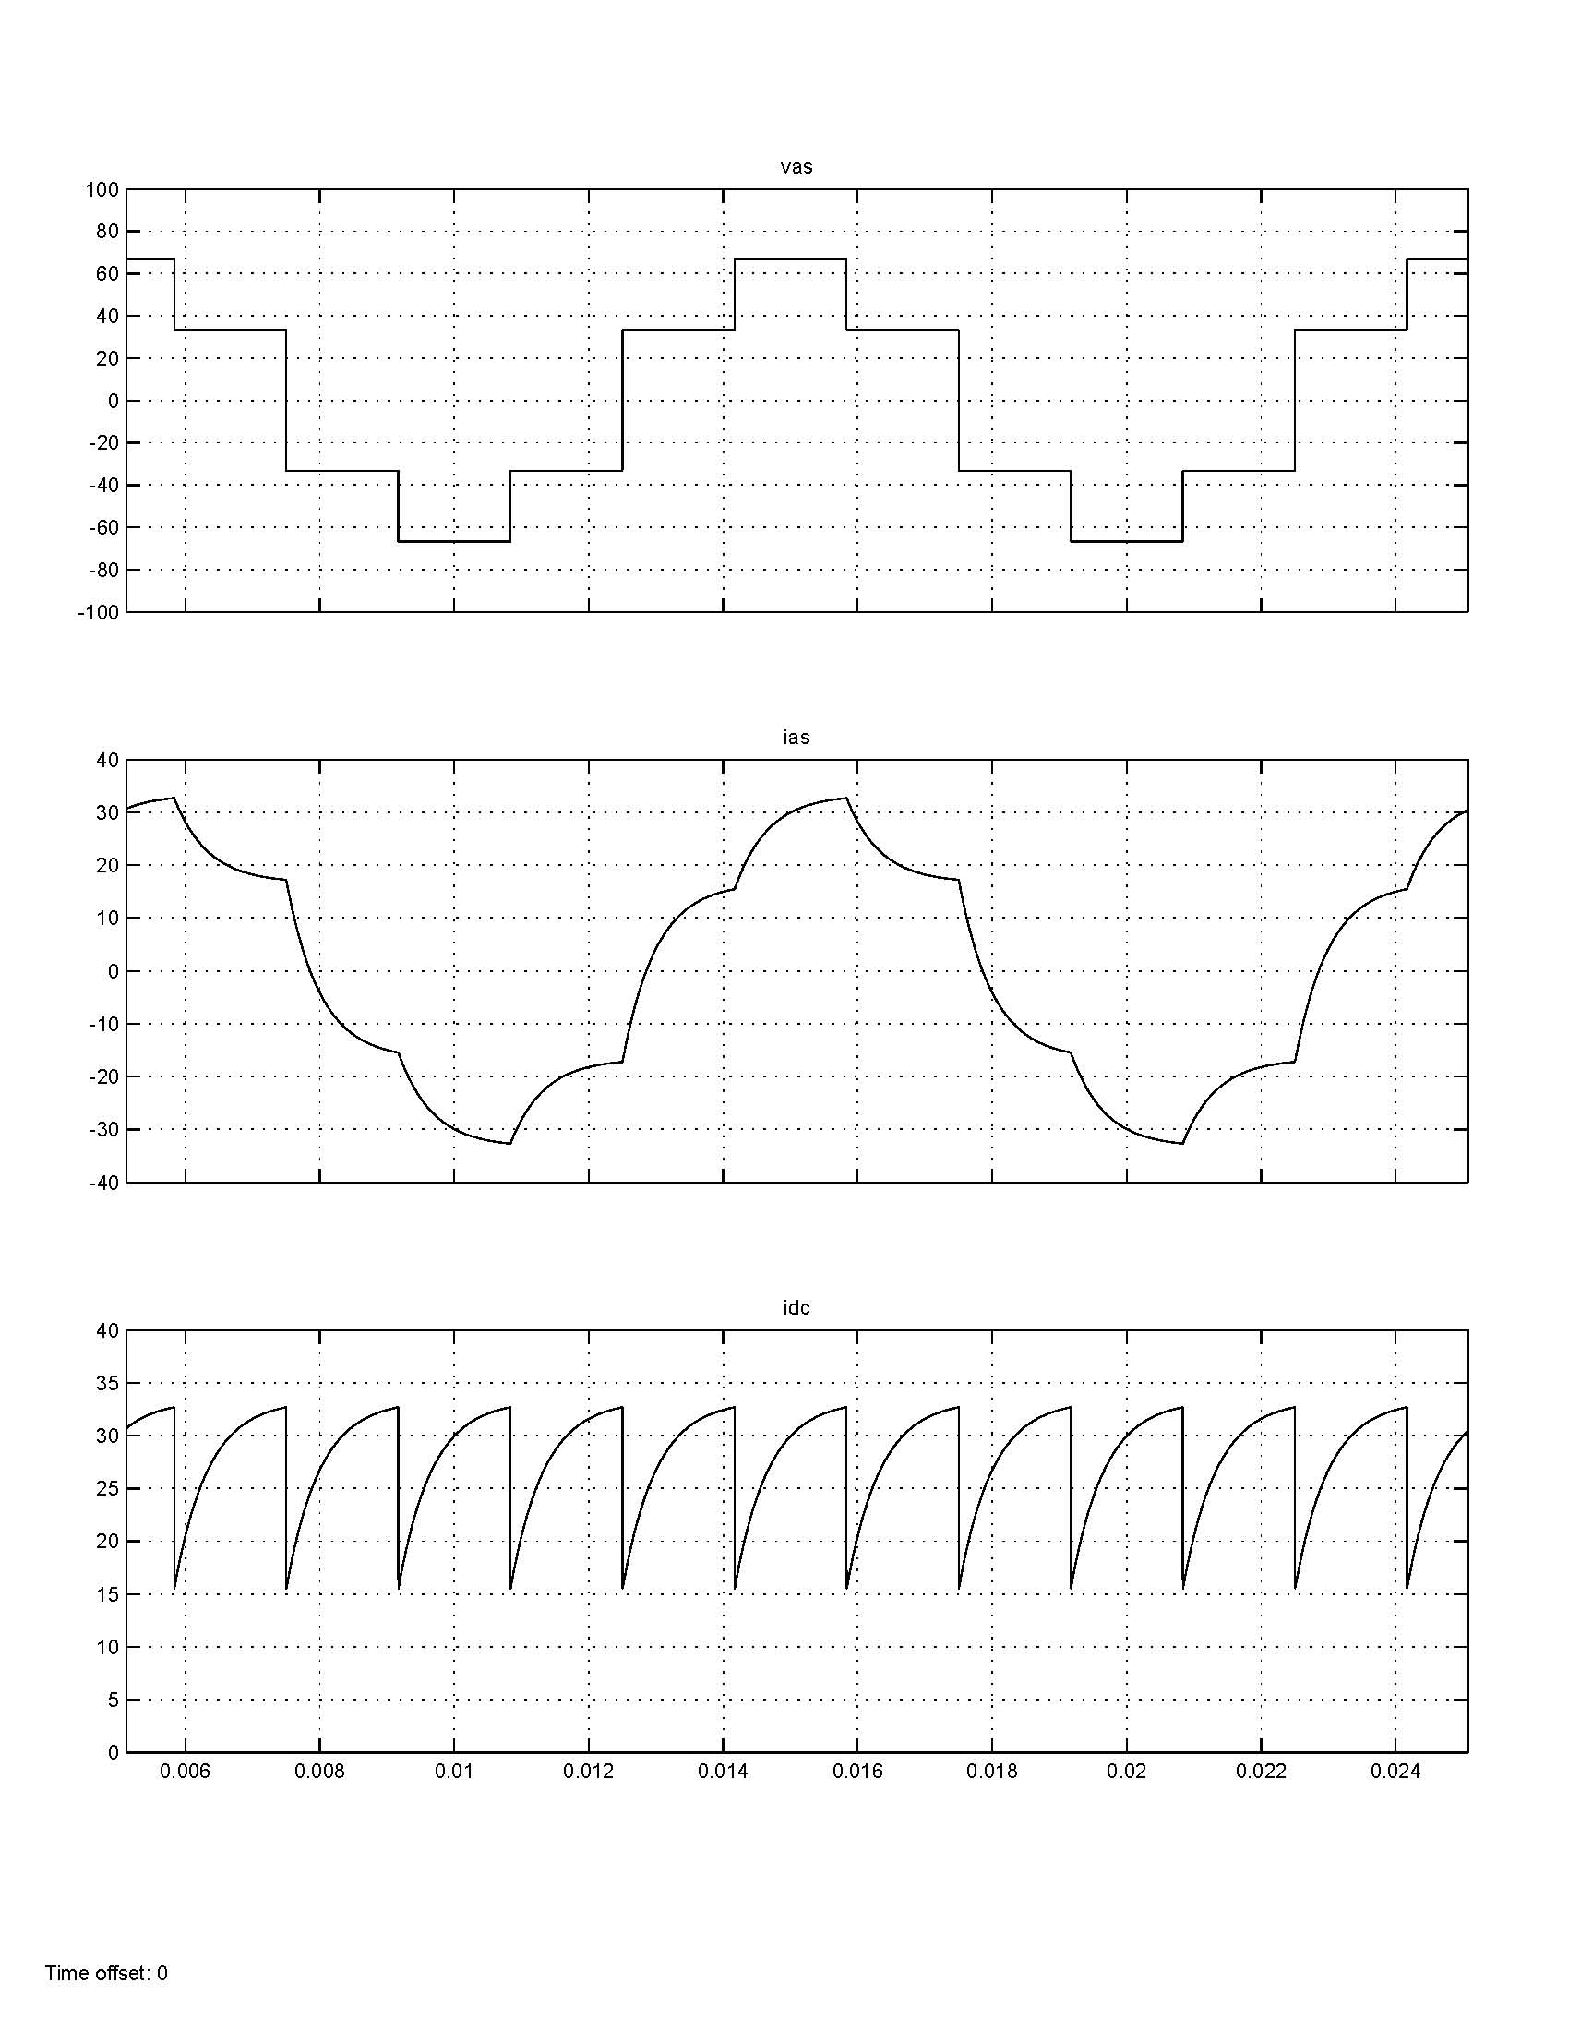
180º VSI Simulink Plots

Slide 26
180º VSI PSCAD Example
Inverter.psc

Slide 27
180º VSI PSCAD Example
Inverter.psc

Slide 28
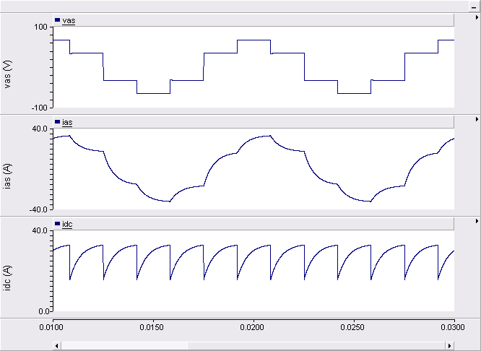
180º VSI PSCAD Plots

Slide 29
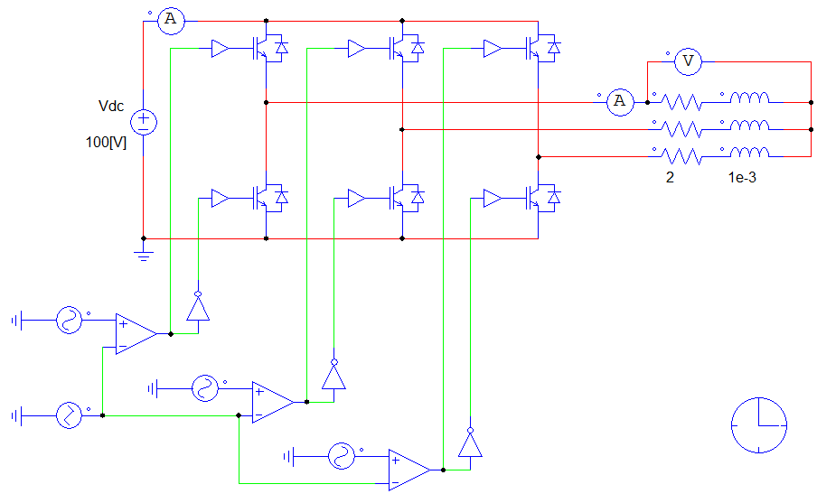
180º VSI PSIM Example
Inverter.psimsch

Slide 30
180º VSI PSIM Plots

Slide 31
180º VSI PSIM FFT

Slide 32
180º VSI Inverter Operation
Based on stepping through the inverter states to produce a quasi-rotating voltage vector.
Fundamental line-to-neutral rms voltage
Fundamental line-to-line rms voltage
Advantages
Simple control
Low switching losses
Disadvantages
Low-frequency harmonics in the output voltages
Voltage amplitude controlled only through v_{dc}

Slide 33
Sine-Triangle Modulation
desired load voltages

Slide 34
Inverter Control
Inverter can control v_{ag}, v_{bg}, and v_{cg} to be any voltage
between 0 and v_{dc} through pulse-width modulation (PWM)

Slide 35
line-to-neutral voltages are expressed in terms of
line-to-ground voltages by
(1)
we may want to solve for v_{ag}*, v_{bg}* and v_{cg}*

Slide 36
However det(A)=0 so A⁻¹ doesn’t exist.
This means that there are an infinite number of sets
of v_{ag}*, v_{bg}* and v_{cg}* for any given set of v_{as}*, v_{bs}*, and v_{cs}*.
In fact, any zero-sequence terms can be added to v_{ag}*, v_{bg}* and v_{cg}*
without affecting v_{as}*, v_{bs}*, and v_{cs}*.

Slide 37
Commanded Line-to-Ground Voltages
Lets try
where d is the modulation index
since 0 ≤ v_{ag} ≤ v_{dc}
then 0 ≤ d ≤ 1

Slide 38
From (1)
for a desired V_{s}*, set

Slide 39
Note that the largest voltage occurs when d = 1
so the largest voltage is
Considering the inverter topology, the largest voltage should be

Slide 40
Third-Harmonic Injection
Try
J.A. Houldsworth and D.A. Grant, "The Use of Harmonic Distortion to Increase the Output Voltage of a Three-Phase PWM Inverter," IEEE Transactions on Industry Applications, volume 20, number 5, pages 1224-1228, September/October 1984.

Slide 41
Note that the cos(3θ_{c}) is a zero-sequence term
In a three-phase system, dc values or triplen harmonics
are zero-sequence terms
From (1)
This is the same as before. Where is the improvement?

Slide 42
Line-to-Ground and Line-to-Neutral Voltages

Slide 43
As it turns out, the third harmonic allows a larger range on d
now
so

Slide 44
Normalize v_{ag}*, v_{bg}*, v_{cg}* to v_{dc} and remove the dc offset
resulting duty cycles

Slide 45
Sine-Triangle Modulation
Compare d_{a}, d_{b}, and d_{c} to a high-frequency triangle wave (period T_{sw} = 1/f_{sw})
switching rules
Typically 2kHz ≤ f_{sw} ≤ 20kHz for industrial drives

Slide 46
Sine-Triangle Modulation Waveforms
In this example:
f = 60 Hz
f_{sw} = 6 kHz

Slide 47
Average-Value Model
Fast average
For small T_{sw}, d_{a} is nearly constant over T_{sw}
so
also

Slide 48
Sine-Triangle Example Calculations

Slide 49
Sine-Triangle Simulink Example
Inverter_Bridge.mdl

Slide 50
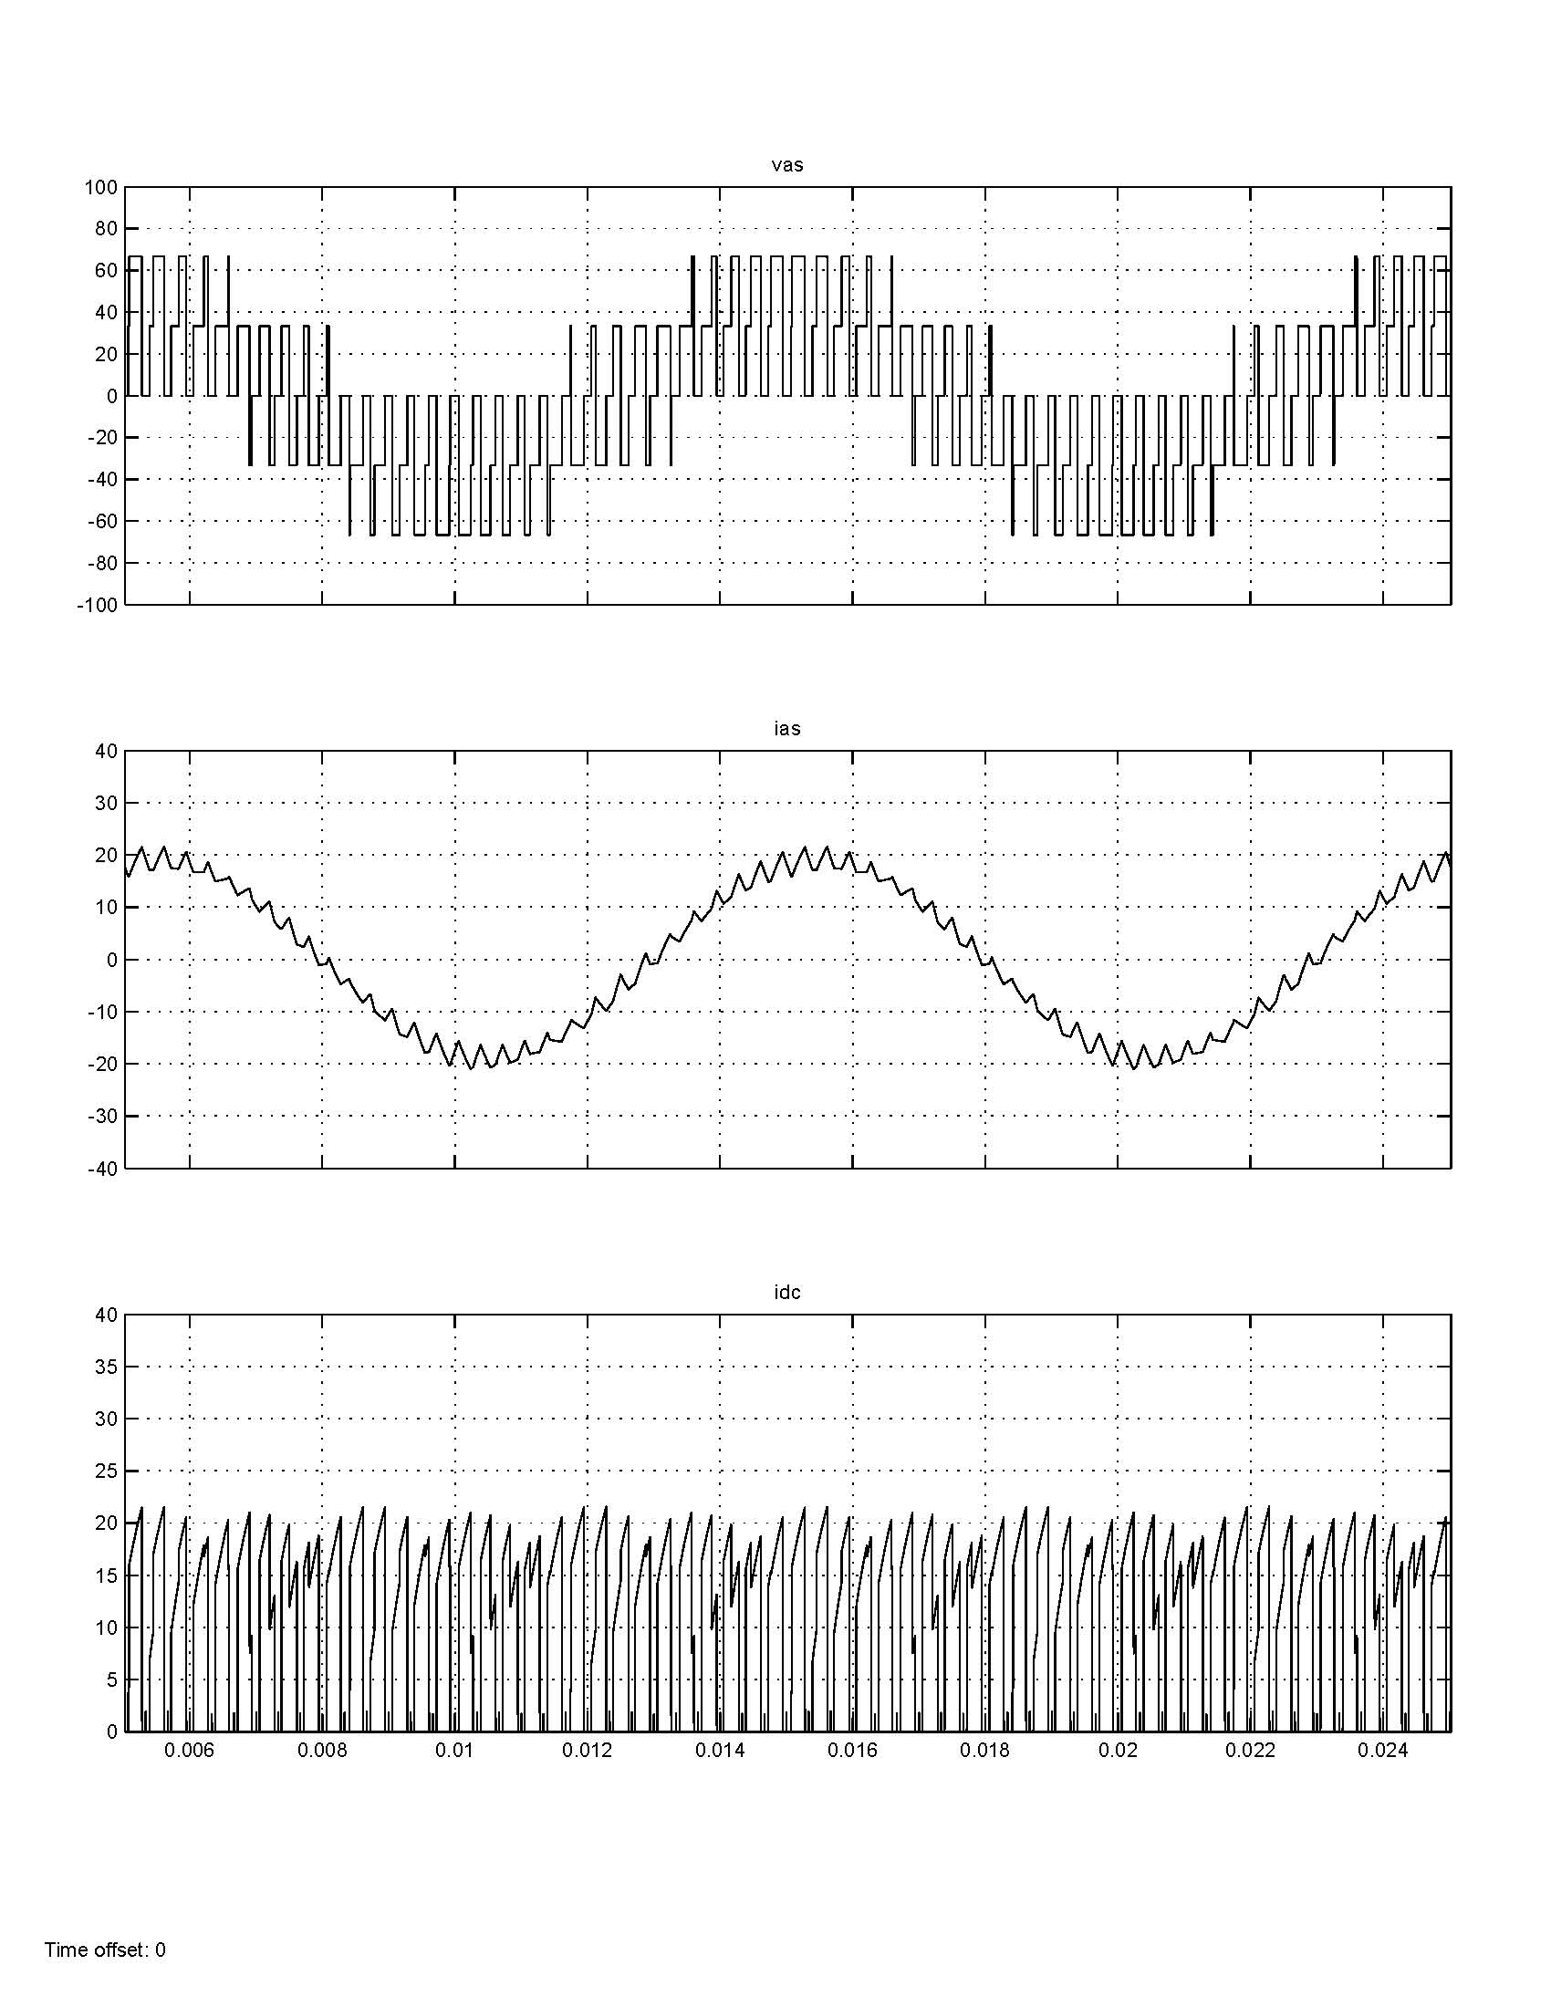
Sine-Triangle Simulink Plots

Slide 51
Sine-Triangle PSCAD Example
Inverter.psc

Slide 52
Sine-Triangle PSCAD Example
Inverter.psc

Slide 53
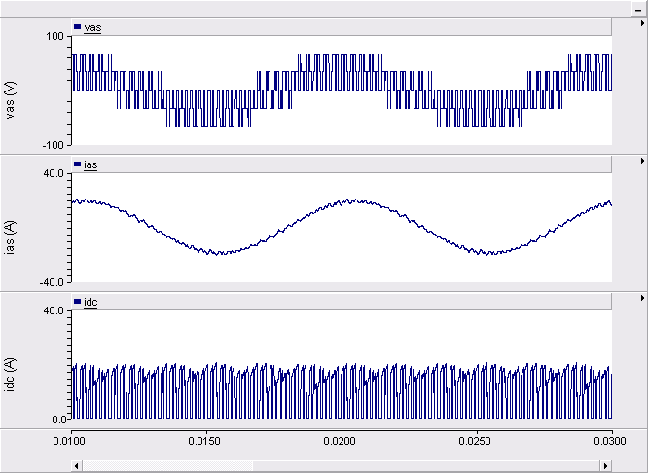
Sine-Triangle PSCAD Plots

Slide 54
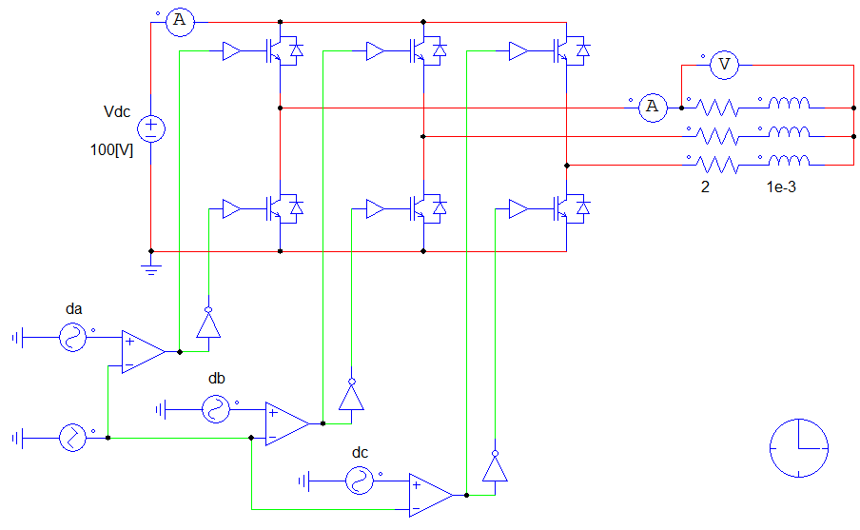
Sine-Triangle PSIM Example
Inverter.sch

Slide 55
Sine-Triangle PSIM Plots

Slide 56
Sine-Triangle PSIM FFT

Slide 57
Voltage-Source Inverter Modulation
The modulation index is a ratio of the ac voltage magnitude to the dc voltage magnitude
Triplin harmonics can be added to the line-to-ground voltages and not affect the line-to-neutral load voltages
Sine-triangle modulation
straightforward implementation
high performance (no low-frequency harmonics)
fundamental line-to-neutral rms voltage (0 ≤ d ≤ 1.15)
fundamental line-to-line rms voltage

Slide 58
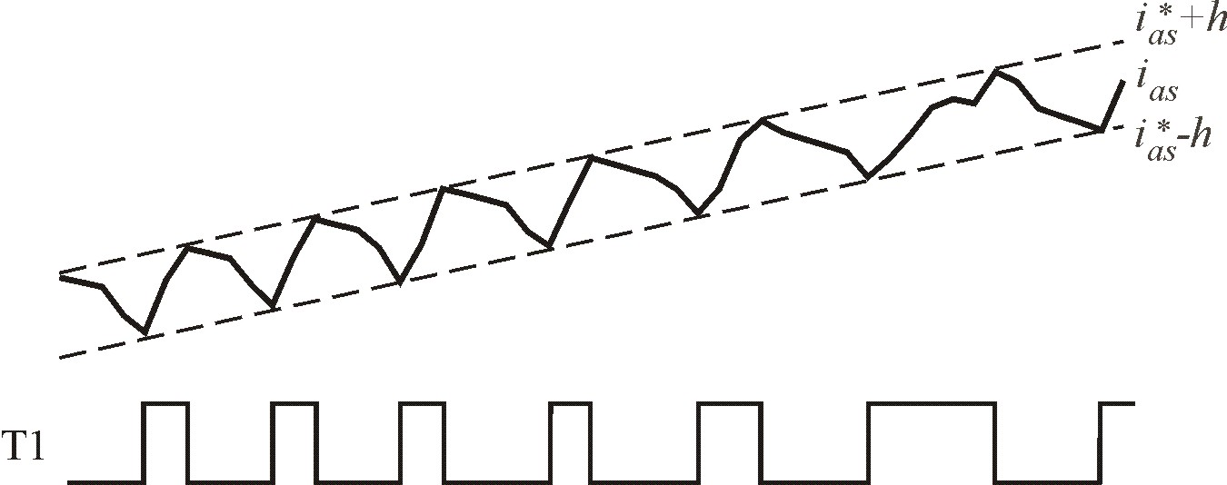
Hysterisis Control
switch transistors on a per-phase basis based on current
h = hysteresis level (A)

Slide 59
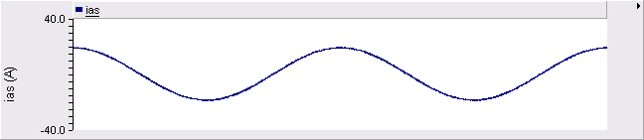
make h small, then current is nearly ideal

Slide 60
Hysteresis Plot
plot switching state versus current error

Slide 61
Inverter Voltage Limit
command I_{s}* and φ_{i}
calculate V_{s}* from I_{s}* load impedance
from the inverter topology,
so

Slide 62
Hysteresis Control Calculations

Slide 63
Hysteresis Control Simulation in Simulink
Inverter_Hysteresis.mdl

Slide 64
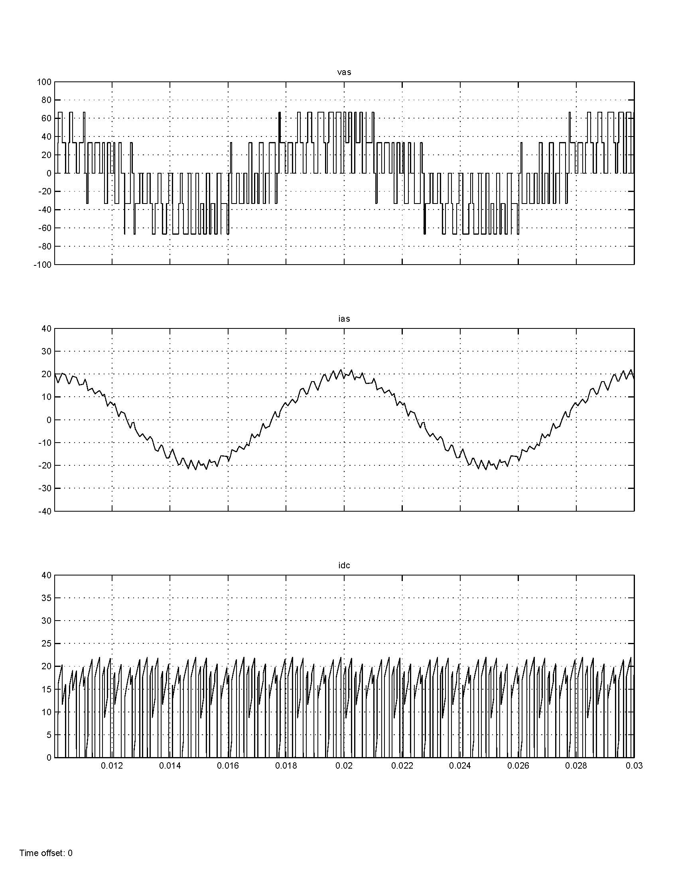
Hysteresis Control Simulink Waveforms

Slide 65
Hysteresis Current-Regulated Modulation
Advantages
direct control of currents which is needed for many applications
currents limited during fault conditions or low-impedance loads
Disadvantages
requires analog comparators for accurate implementation
switching frequency varies and depends on load

